Slide 1
Reinforcement Learning
Ismail Firoz

Slide 2
Outline
Introduction
Markov Decision Process (MDP)
Dynamic Programming
Monte-Carlo Methods
Temporal-Difference Methods
Value Function Approximation
Policy Gradient

Slide 3
Introduction

Slide 4

Reinforcement Learning
Reinforcement learning (RL) is the task of learning how agents ought to take sequences of actions in an environment in order to maximize cumulative rewards.

Slide 5
Formalism of RL
Almost all RL problems can be formalised as Markov decision process (MDP).

Slide 6
Markov Decision Process

Slide 7
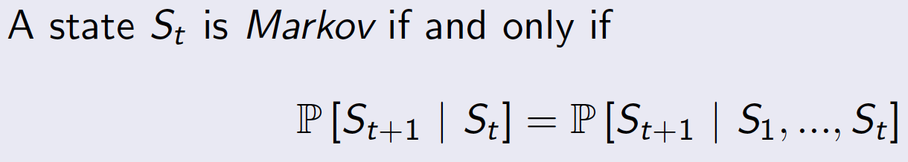
Markov Property
That is, the future is independent of the past given the present.

Slide 8
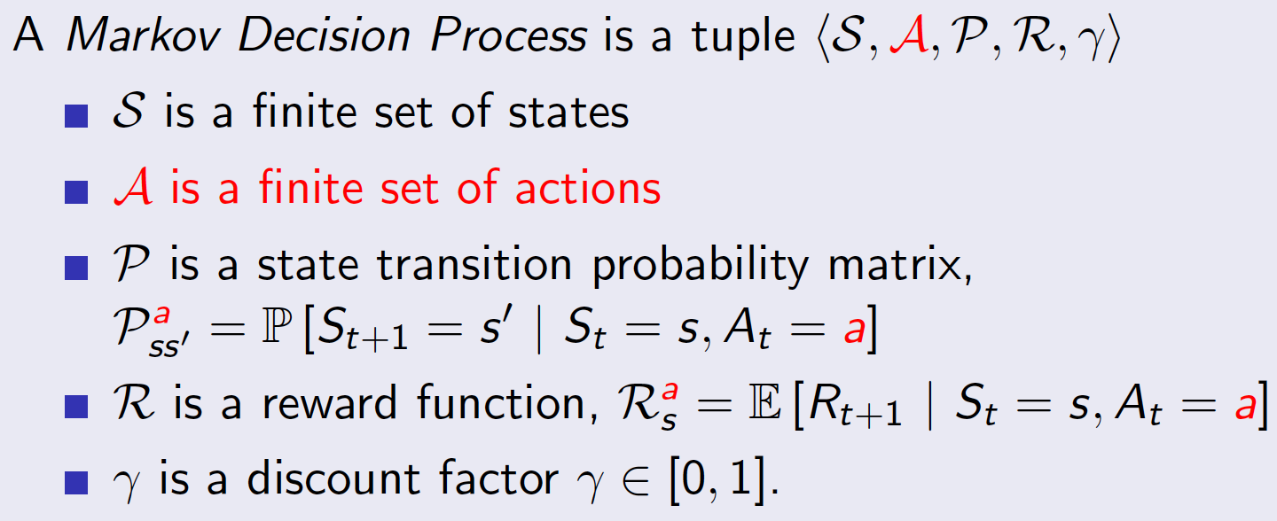
Markov Decision Process
It is an environment in which all states are Markov.
Definition:

Slide 9
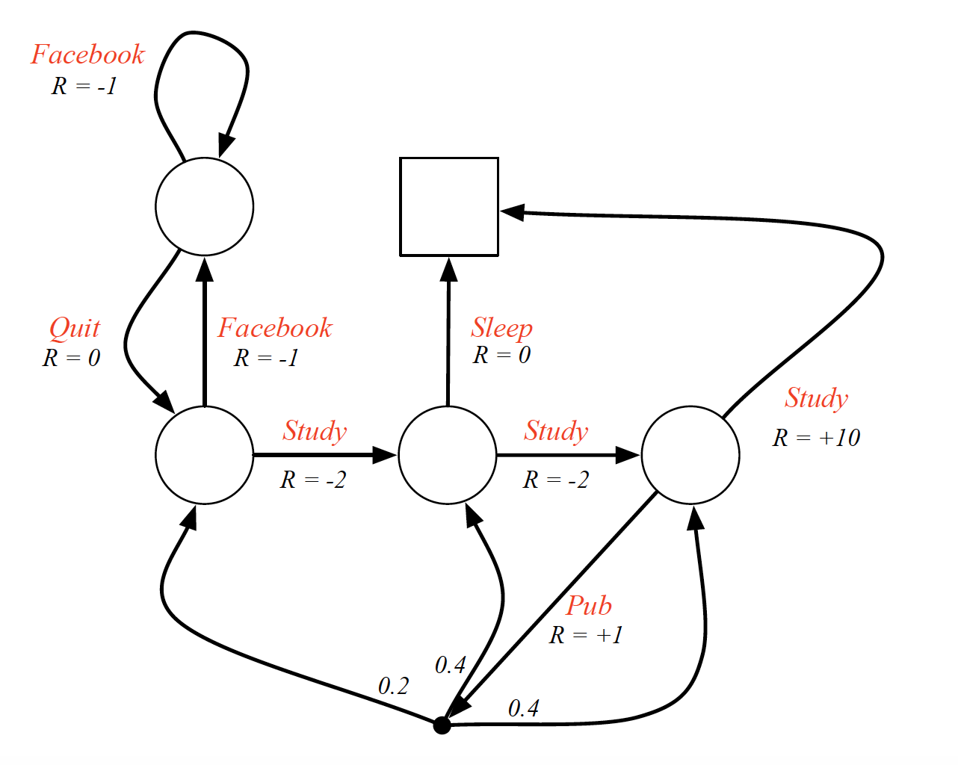
Example: Student MDP

Slide 10
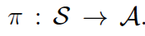
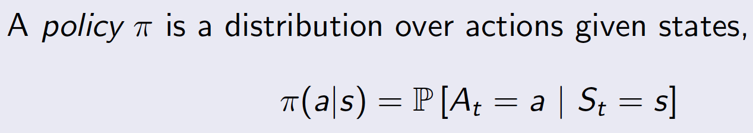
Policy
A policy is a rule used by an agent to decide what actions to take. It can be deterministic, or stochastic.
Deterministic case:
A policy is a mapping from the state space to the action space,
Stochastic case:

Slide 11
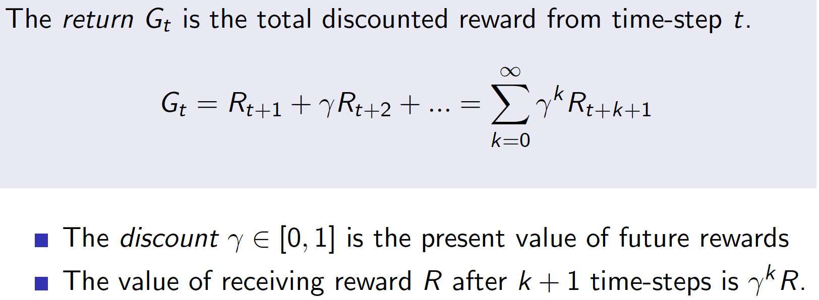
Return

Slide 12
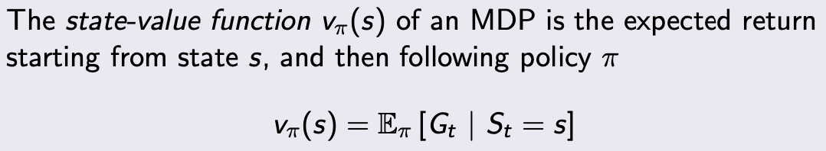
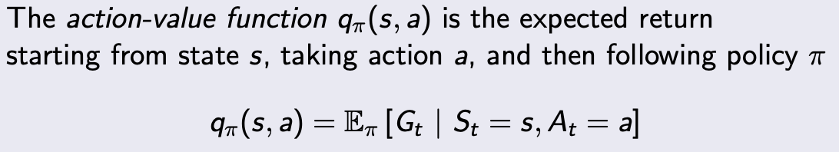
State-value function
Action-value function

Slide 13
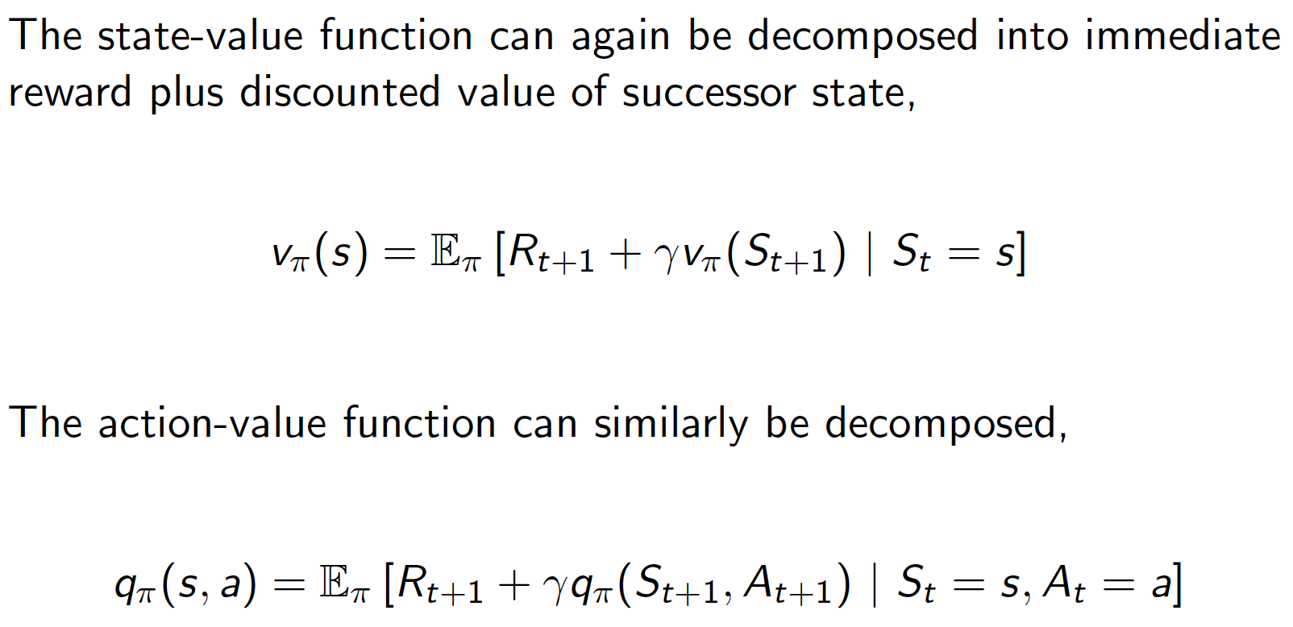
Bellman Expectation Equation

Slide 14
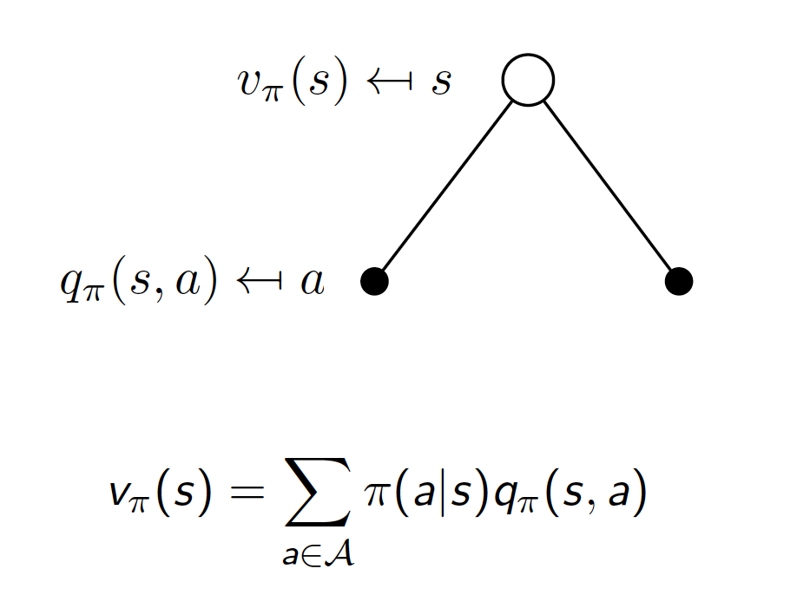
Bellman Expectation Equation for V_(𝜋)

Slide 15
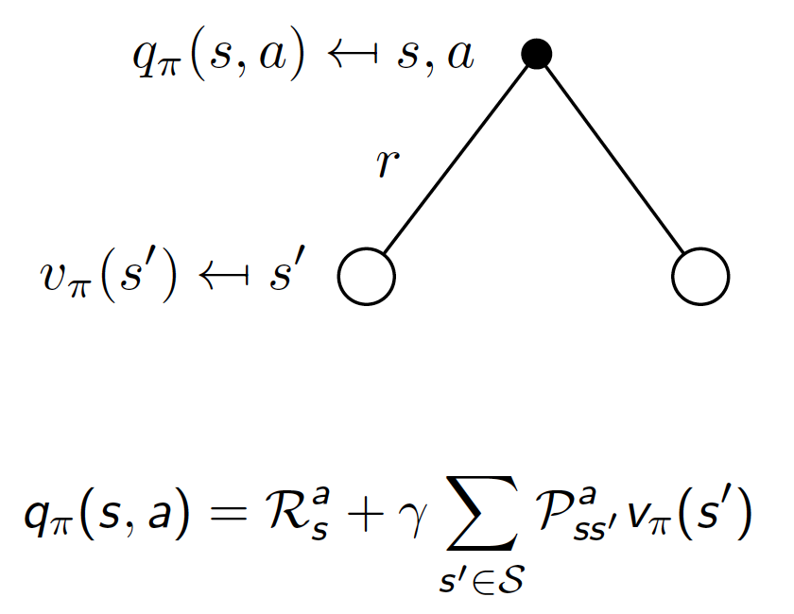
Bellman Expectation Equation for Q_(𝜋)

Slide 16
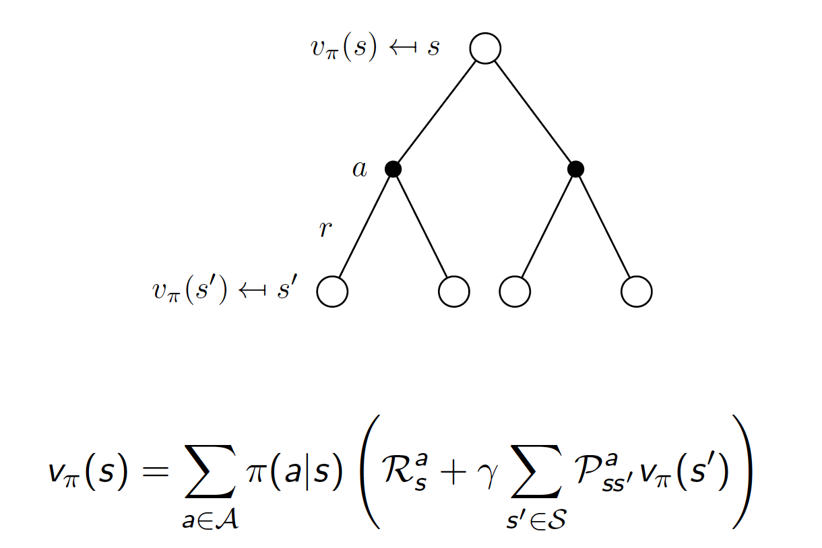
Bellman Expectation Equation for V_(𝜋) (2-Step LA)

Slide 17
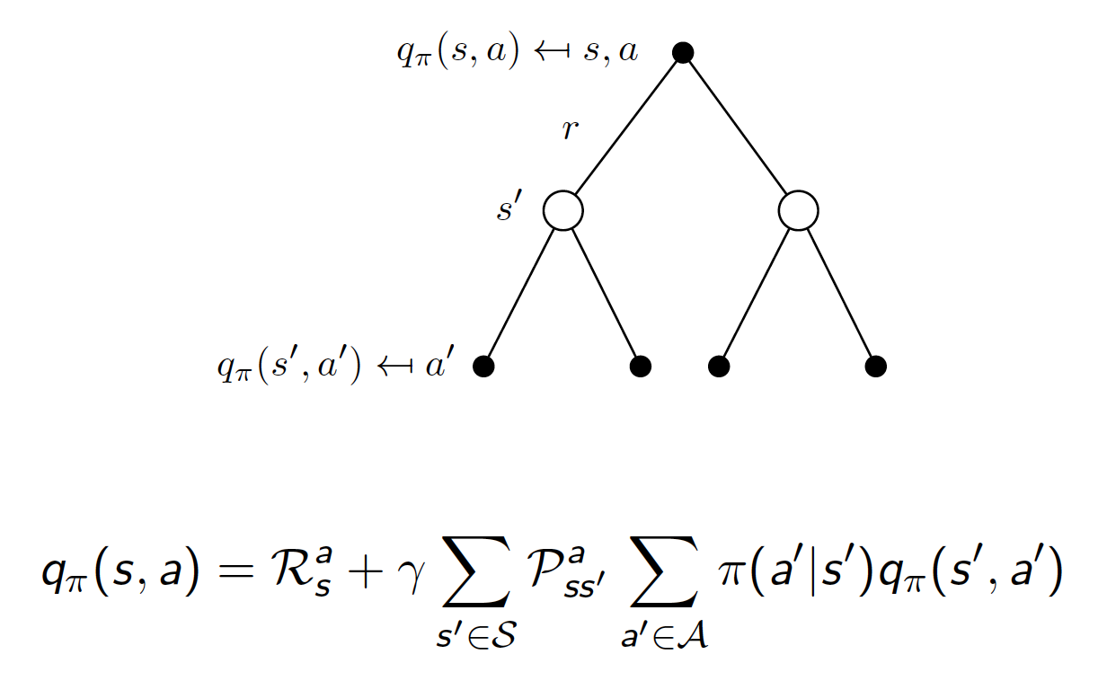
Bellman Expectation Equation for Q_(𝜋) (2-Step LA)

Slide 18
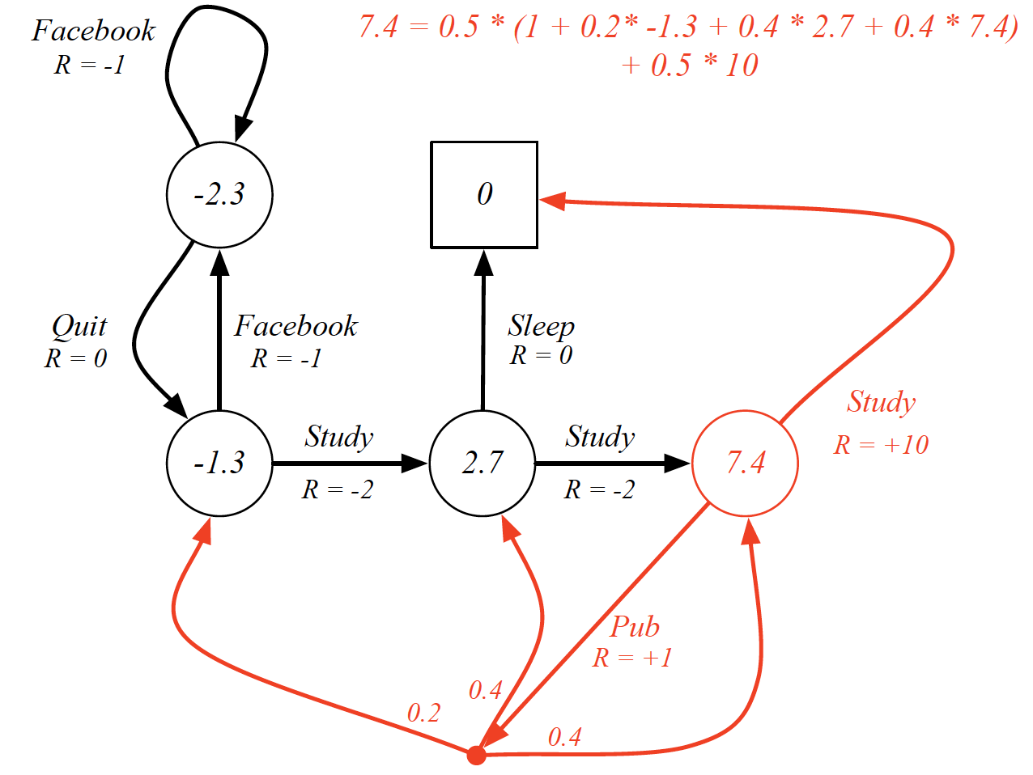
Ex: Bellman Expectation Equation in Student MDP

Slide 19
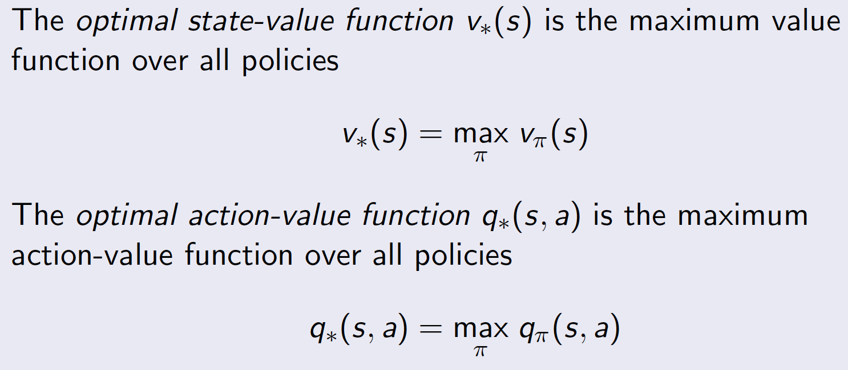
Optimal Value Function
An MDP is solved when we know the optimal value function.

Slide 20
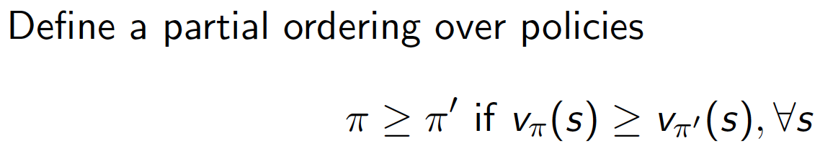
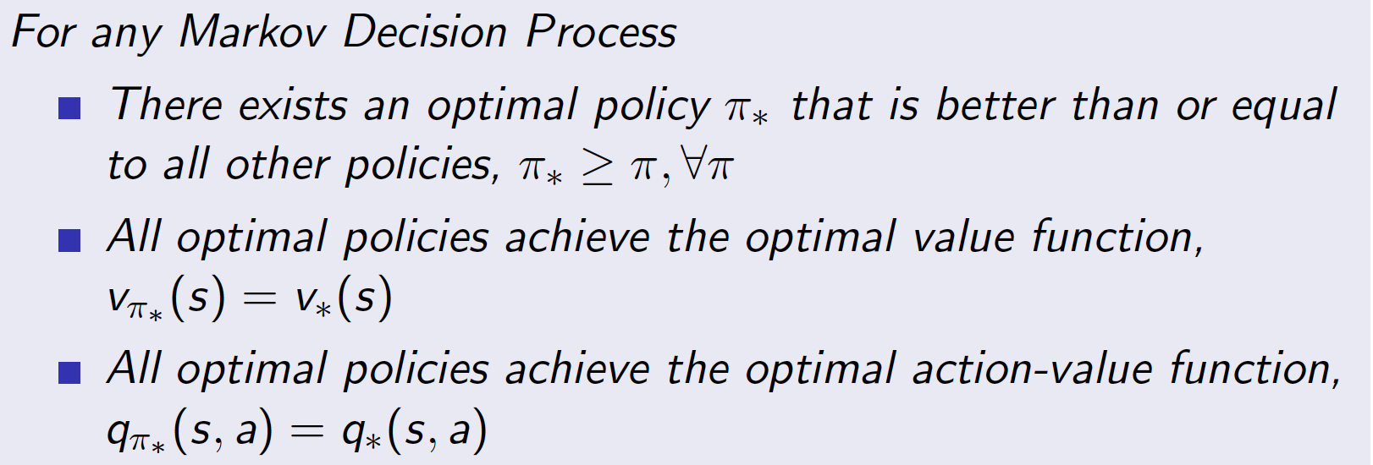
Optimal Policy
Theorem:

Slide 21
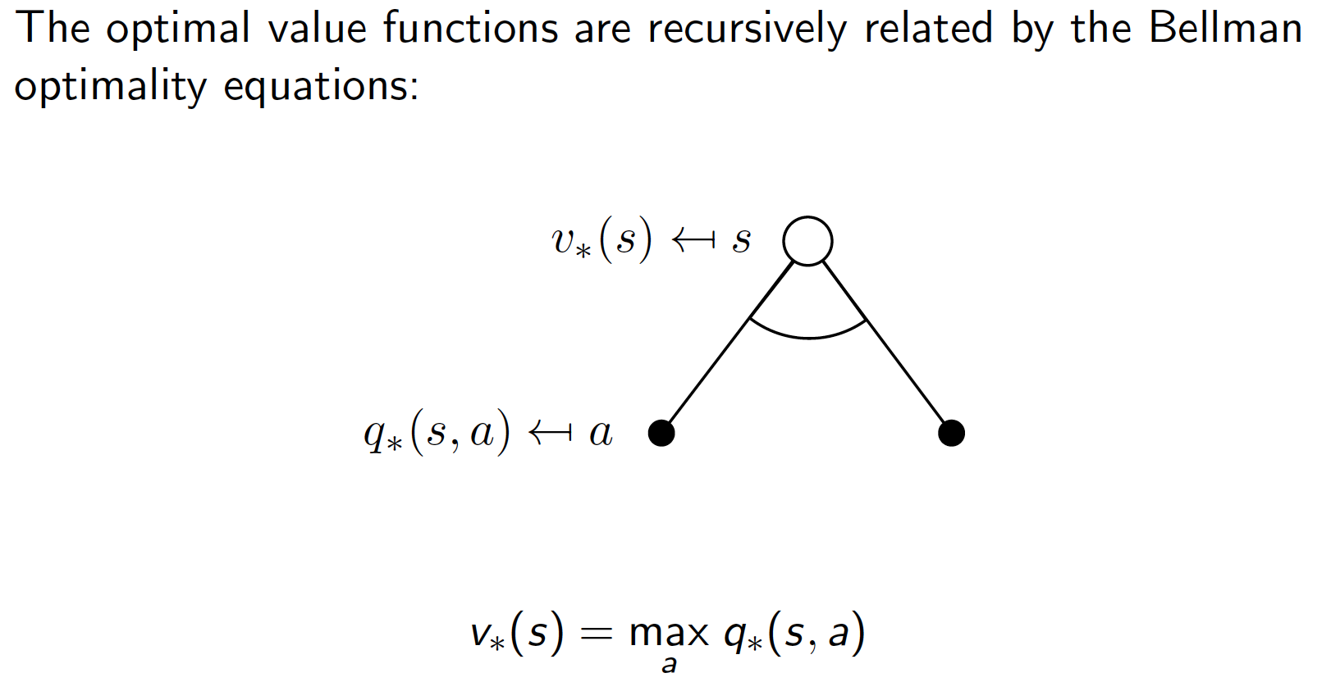
Bellman Optimality Equation for V_(*)

Slide 22
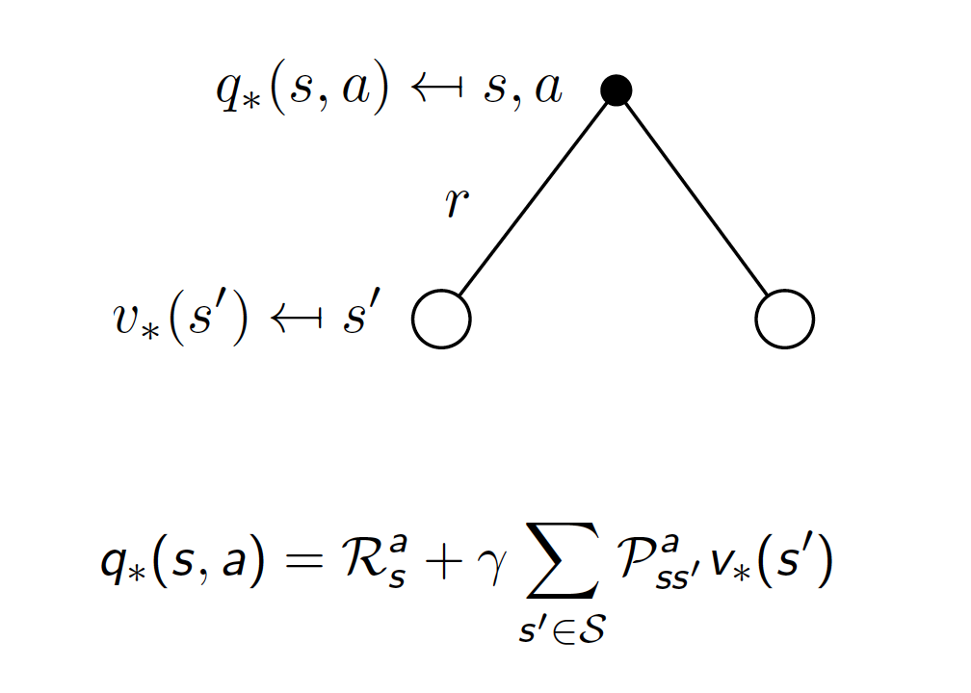
Bellman Optimality Equation for Q_(*)

Slide 23
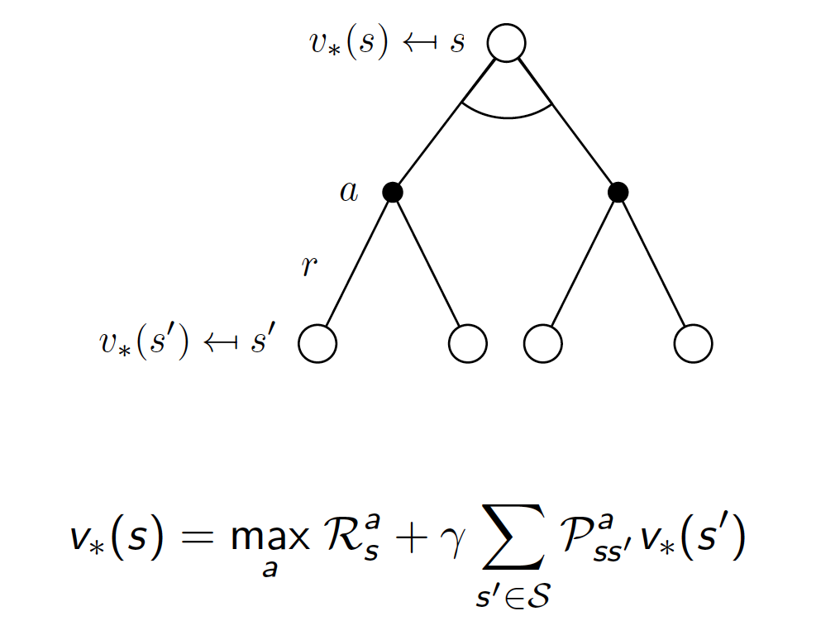
Bellman Optimality Equation for V_(*) (2-Step LA)

Slide 24
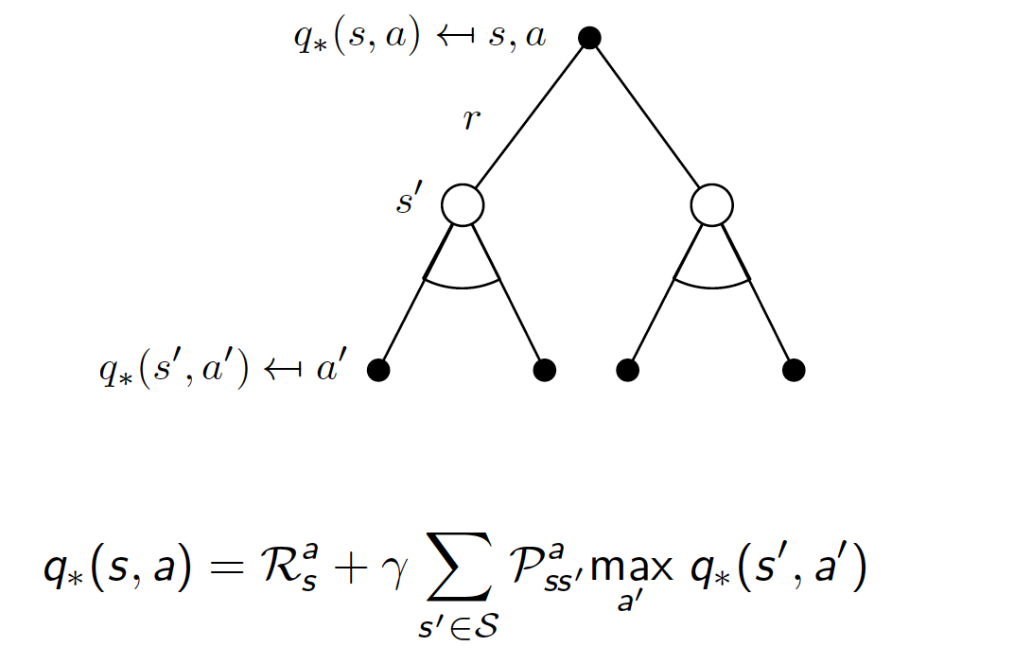
Bellman Optimality Equation for Q_(*) (2-Step LA)

Slide 25
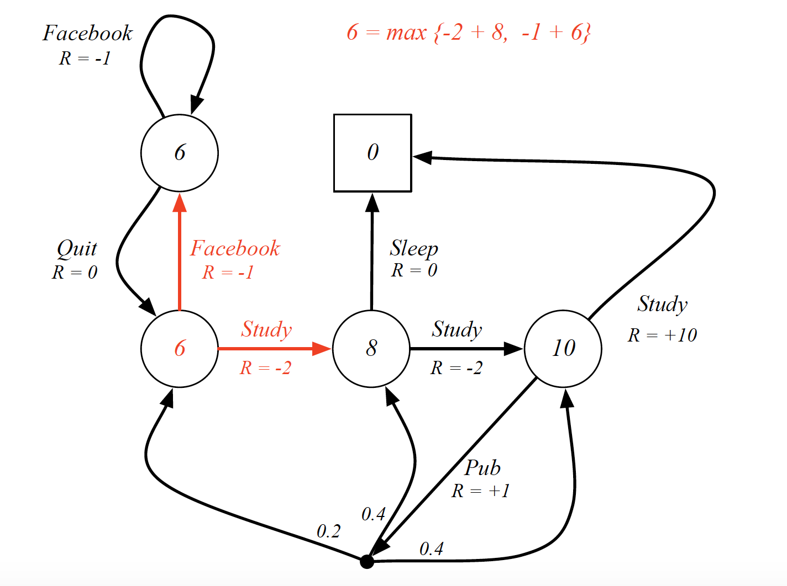
Ex: Bellman Optimality Equation in Student MDP

Slide 26
Techniques for solving MDPs
Dynamic Programming
Monte-Carlo Methods (MC)
Temporal Difference (TD) Learning

Slide 27
Dynamic Programming

Slide 28
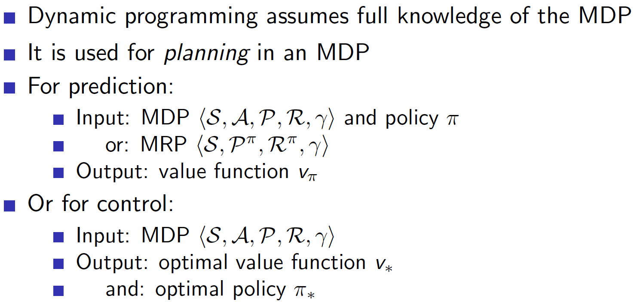
Dynamic Programming

Slide 29
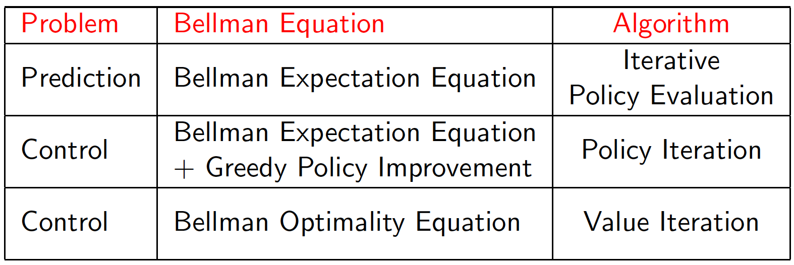
Dynamic Programming Algorithms

Slide 30
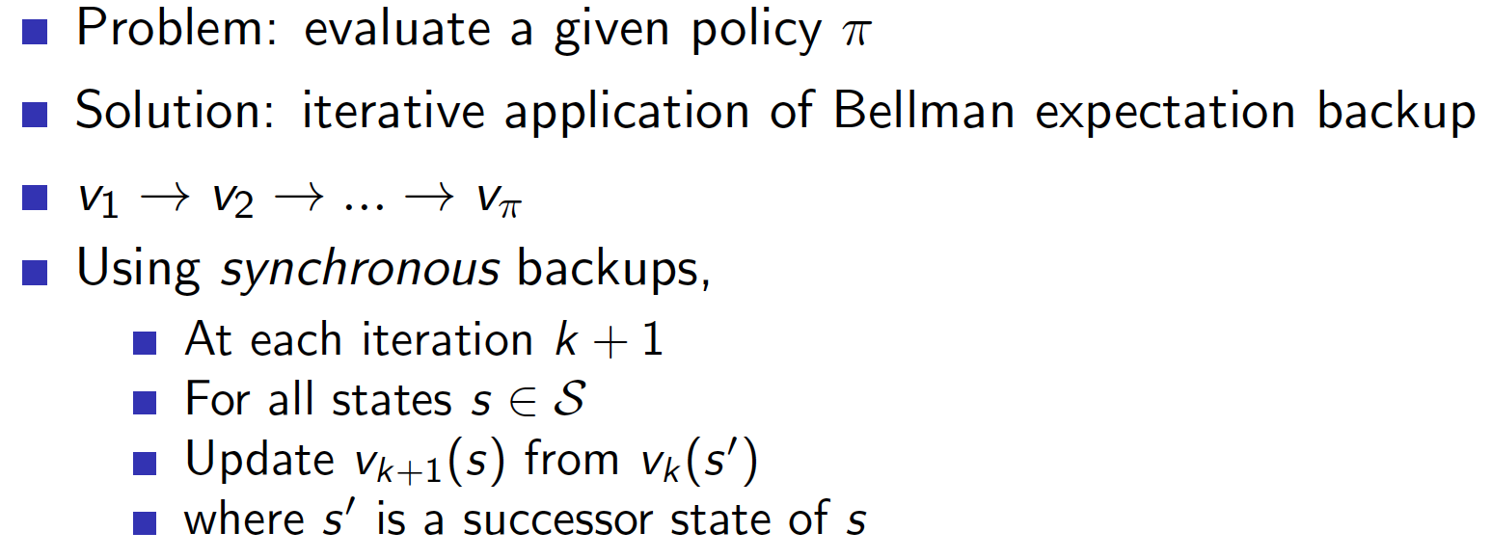
Iterative Policy Evaluation

Slide 31
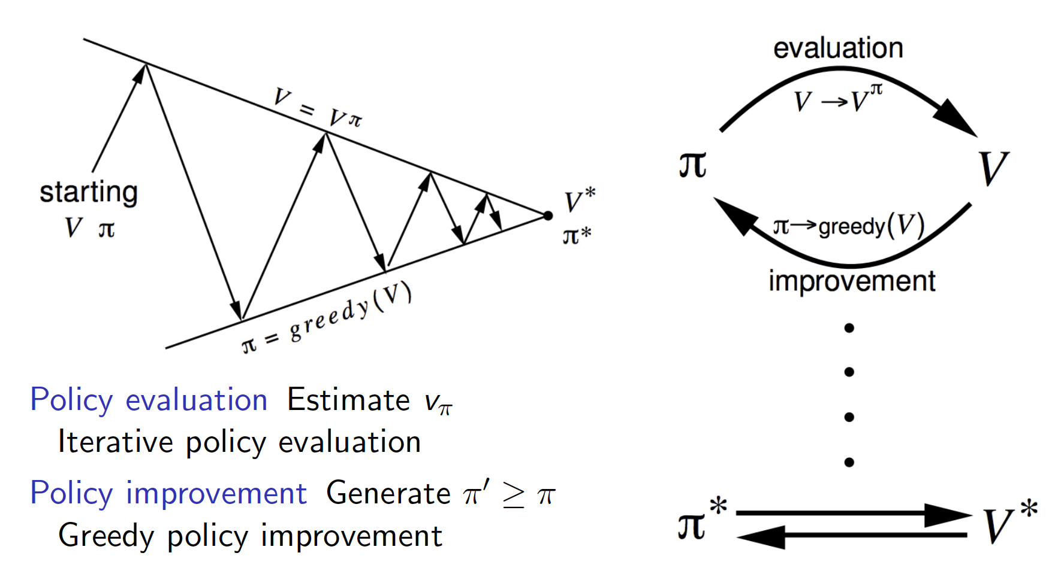
Policy Iteration

Slide 32
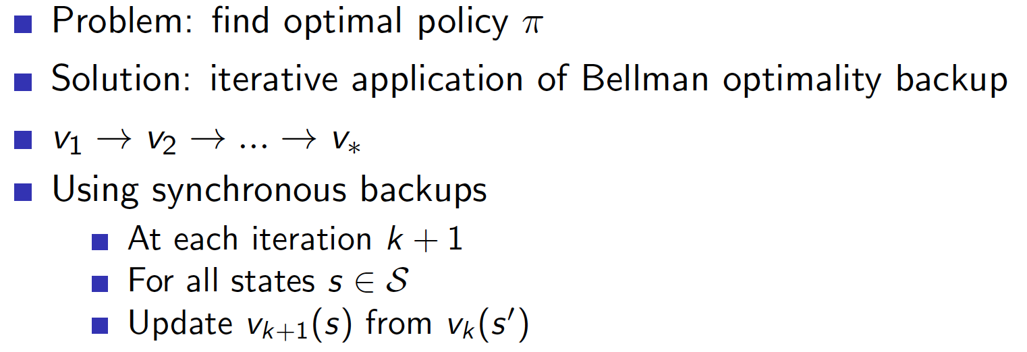
Value Iteration

Slide 33
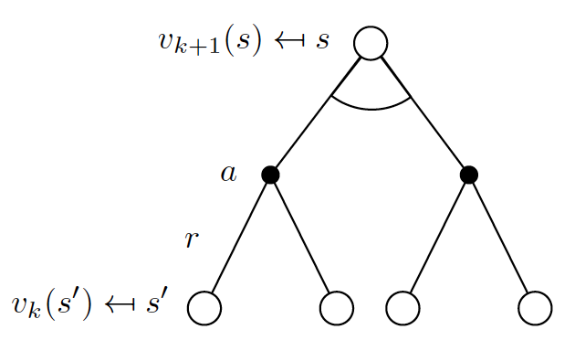
Limitations Of Dynamic Programming
DP uses full-width backups.
For each backup, every successor state and action is considered using the MDP transitions and reward function.
DP is effective for medium-sized problems (millions of states).
For large problems DP suffers Bellman’s curse of dimensionality,
Number of states n=|S| grows exponentially with number of state variables.
Even one backup can be too expensive.

Slide 34
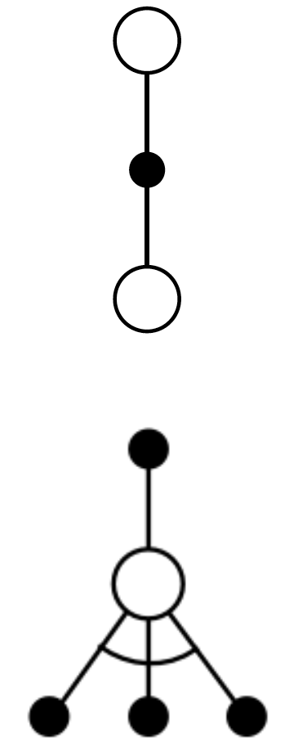
Sample Backups → Model Free RL
Now on, we will consider sample backups using sample rewards and sample transitions < S, A, R, S’ >.
We are not using reward function R and transition dynamics P.
Since we are sampling the dynamics of the environment, we don’t need to know the model of the environment.
This is how we convert from DP methods to model-free RL methods.

Slide 35
Model-Free Prediction

Slide 36
Model-Free Prediction
Monte-Carlo Methods

Slide 37
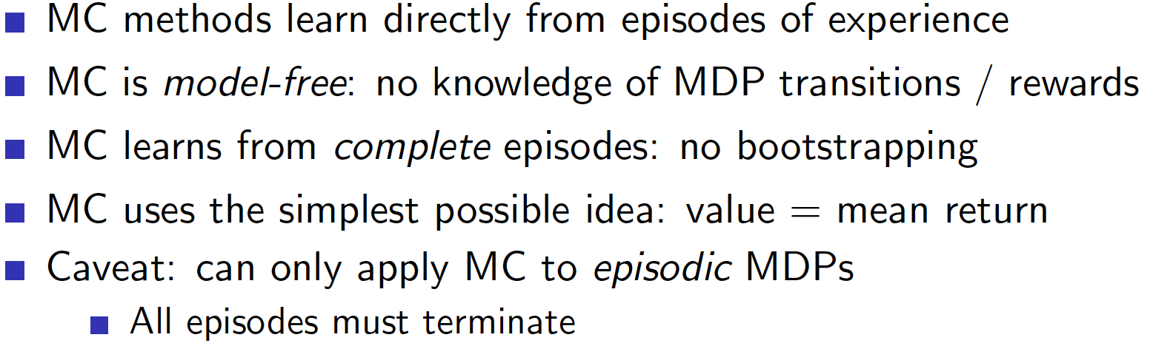
Monte-Carlo Prediction

Slide 38
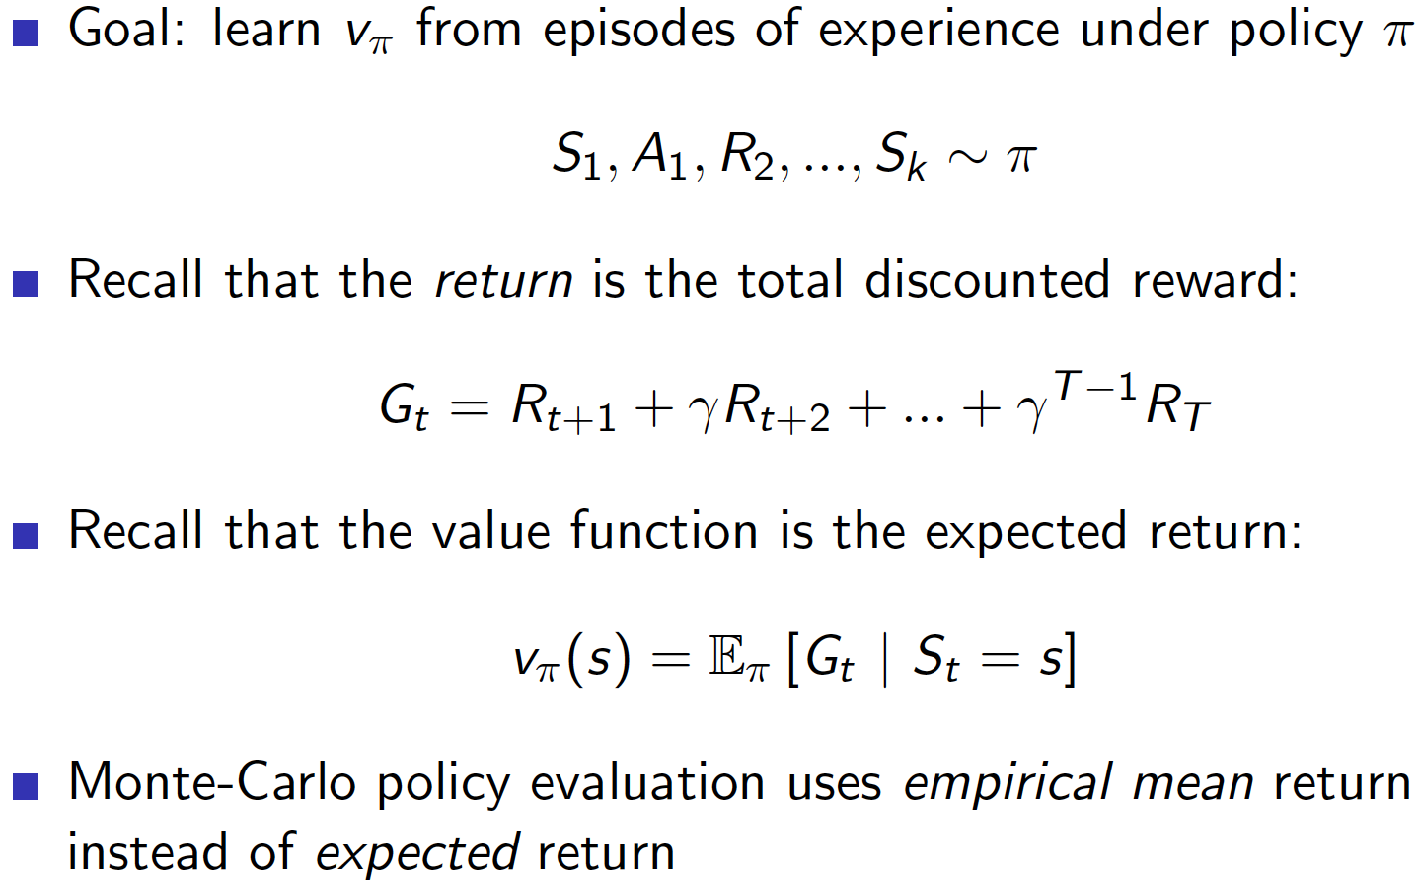
Monte-Carlo Policy Evaluation

Slide 39
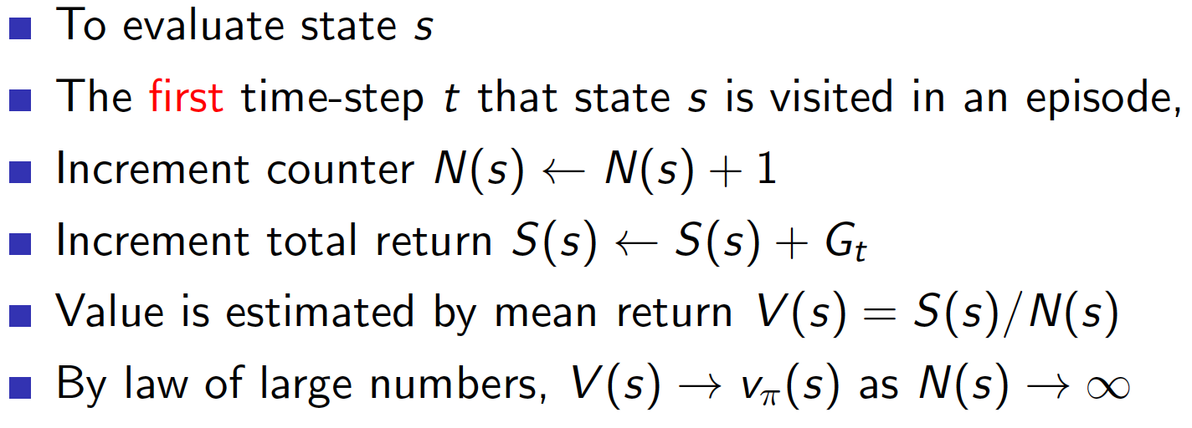
First-Visit Monte-Carlo Policy Evaluation

Slide 40
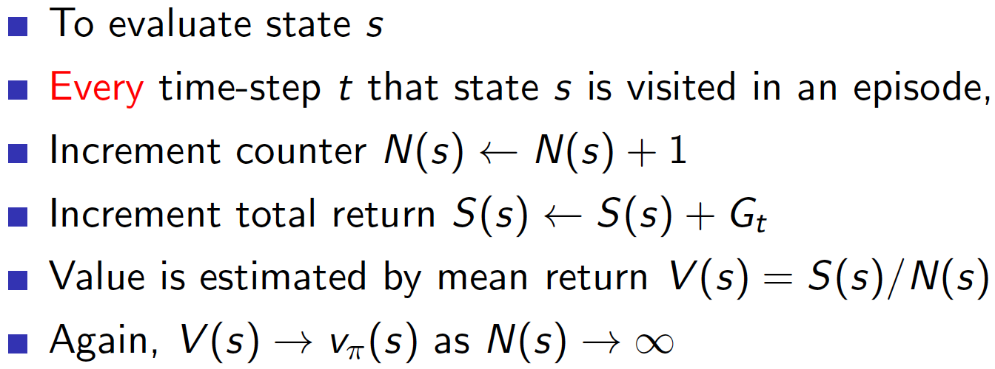
Every-Visit Monte-Carlo Policy Evaluation

Slide 41
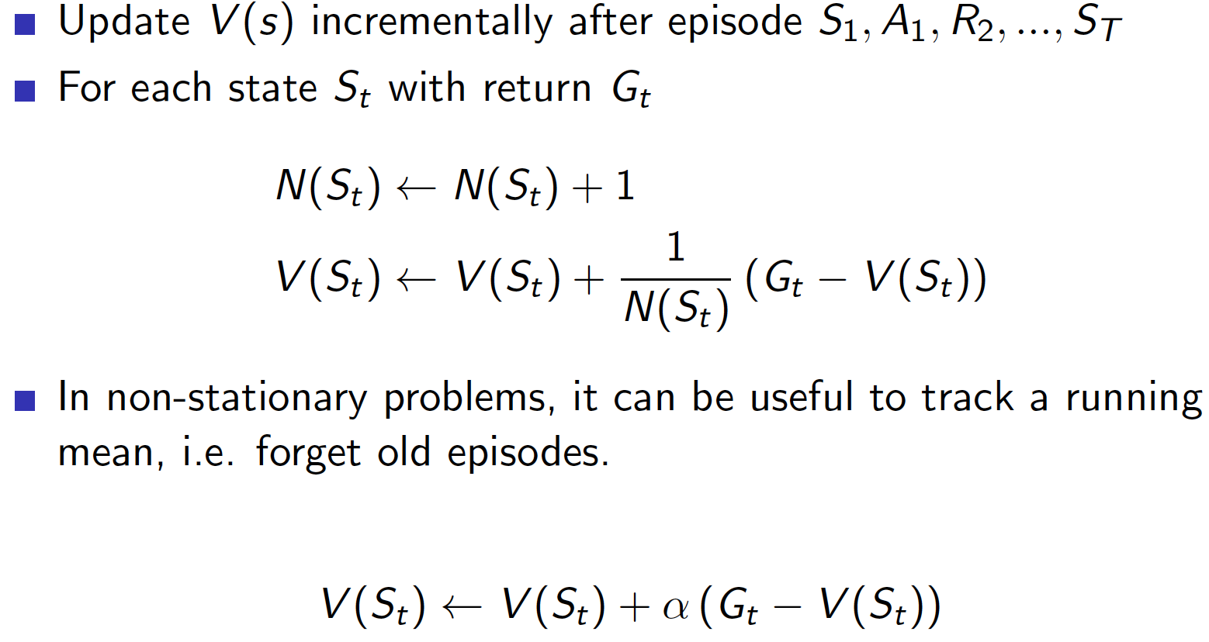
Incremental Monte-Carlo Updates

Slide 42
Model-Free Prediction
Temporal Difference Methods

Slide 43
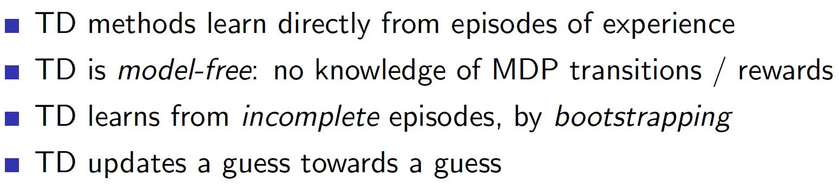
Temporal-Difference Learning

Slide 44
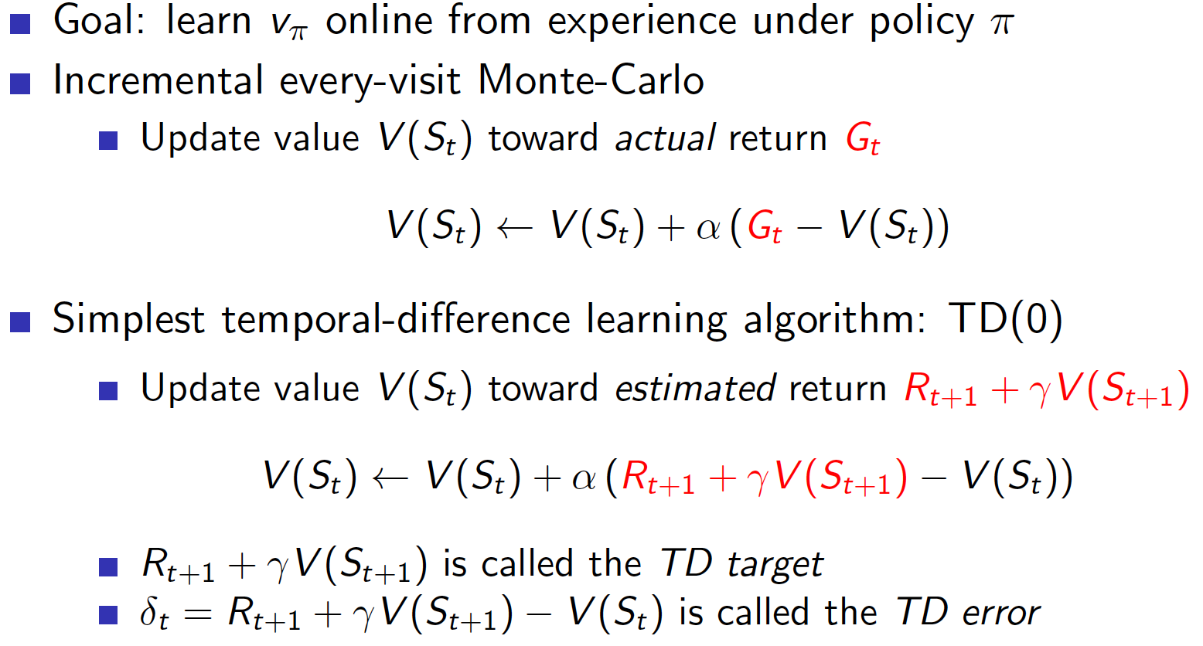
MC and TD

Slide 45
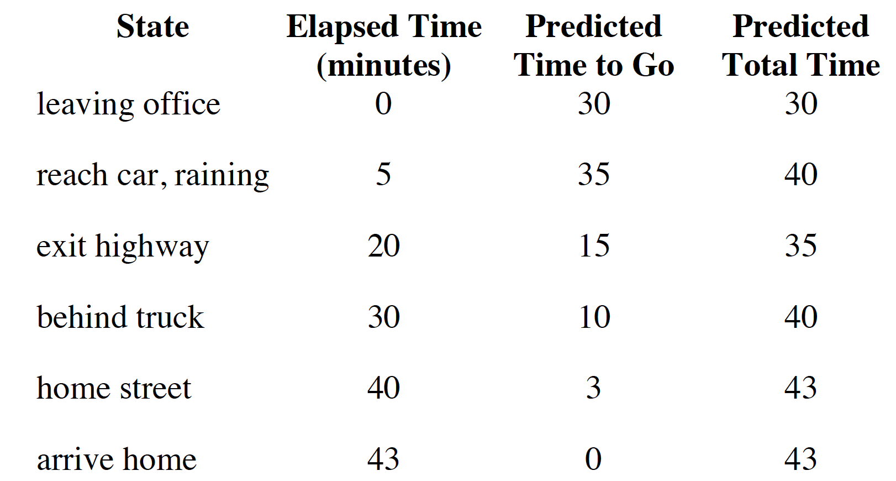
TD Example: Driving Home

Slide 46
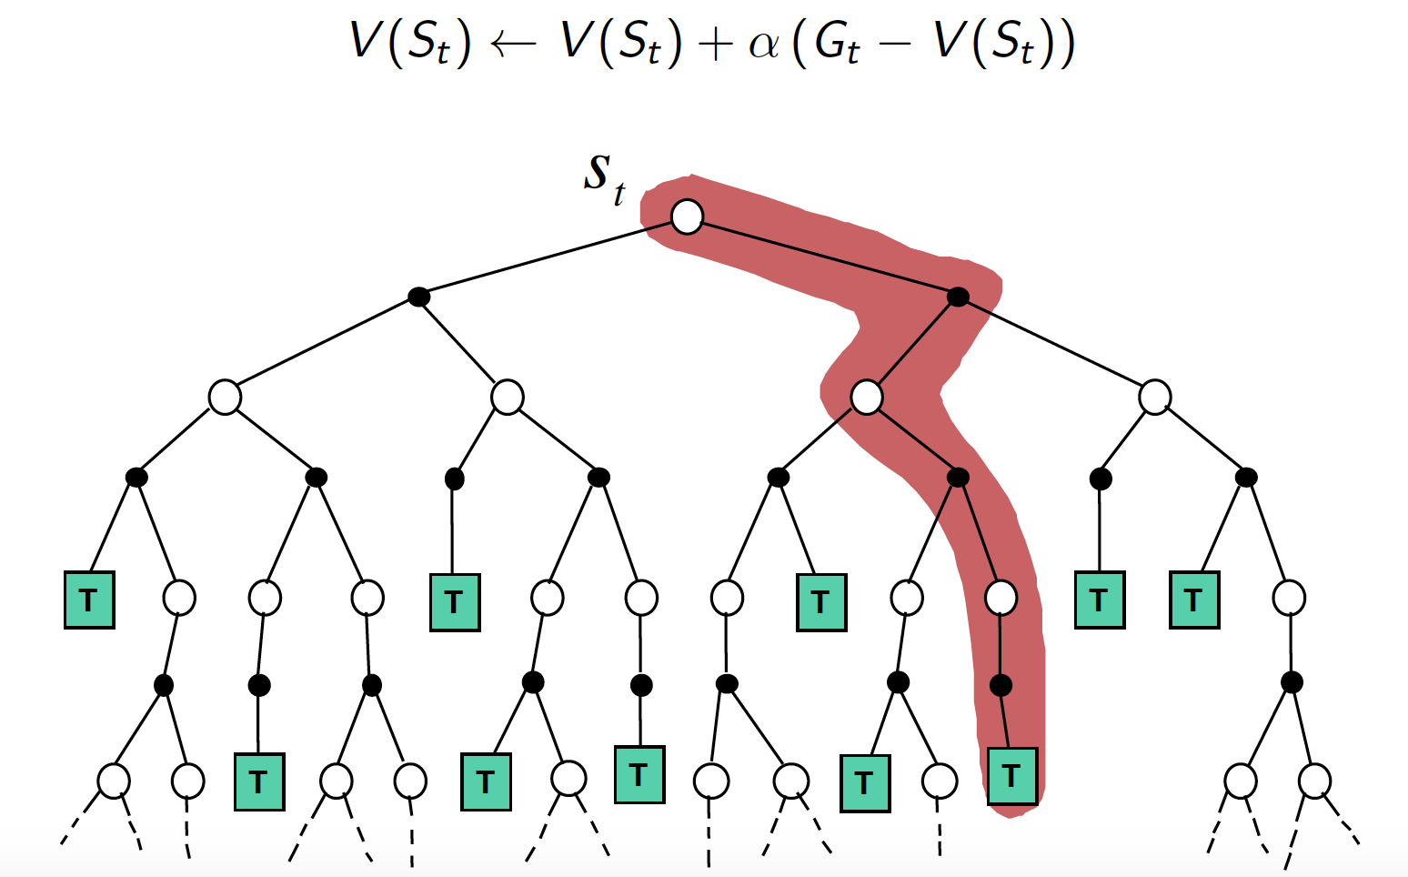
Monte-Carlo Backup

Slide 47
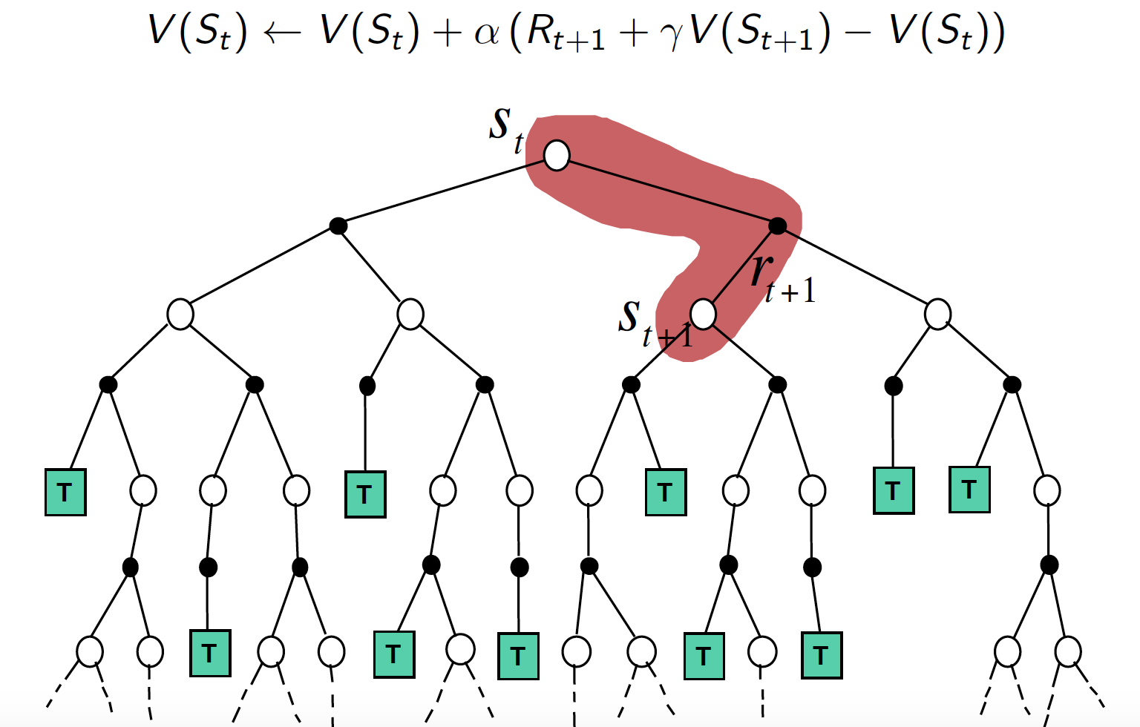
TD(0) Backup

Slide 48
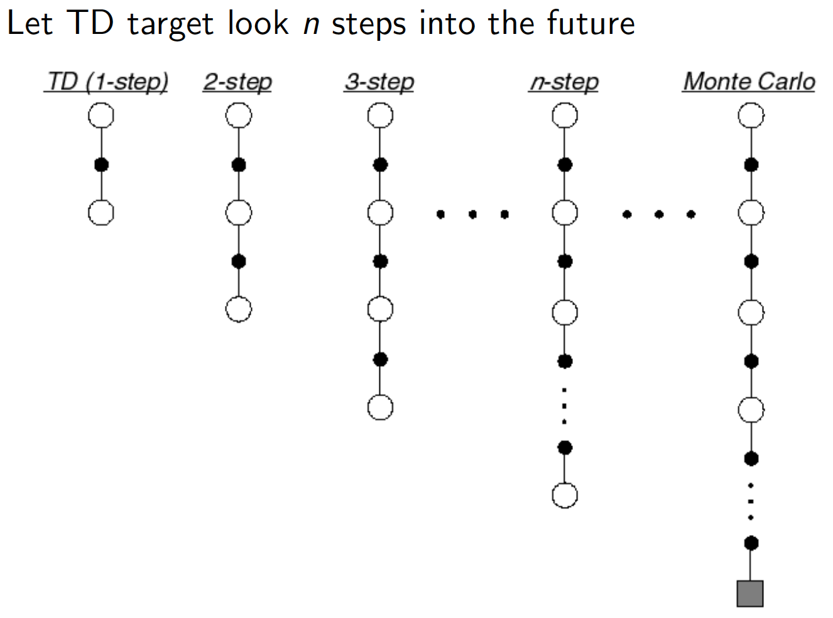
TD n-Step Prediction

Slide 49
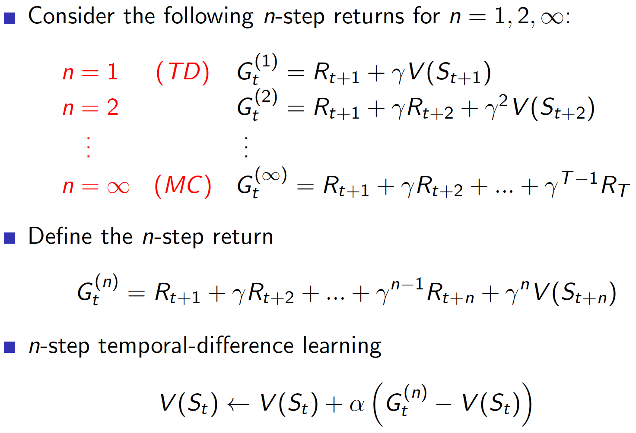
TD n-Step Return

Slide 50
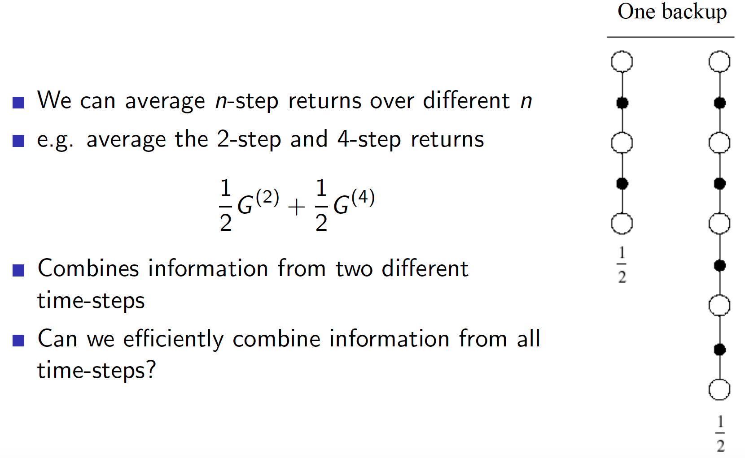
Averaging n-Step Returns

Slide 51
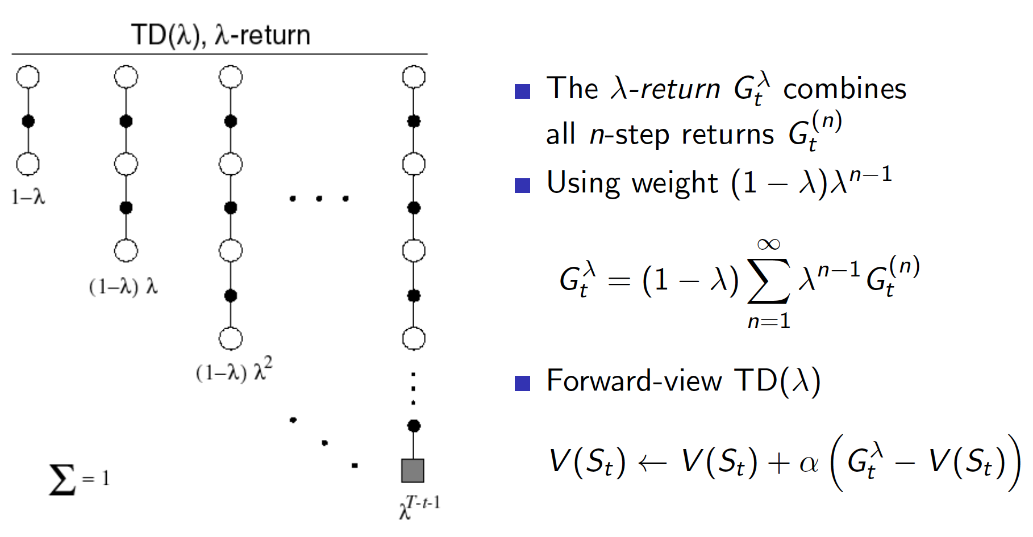
λ-Return

Slide 52
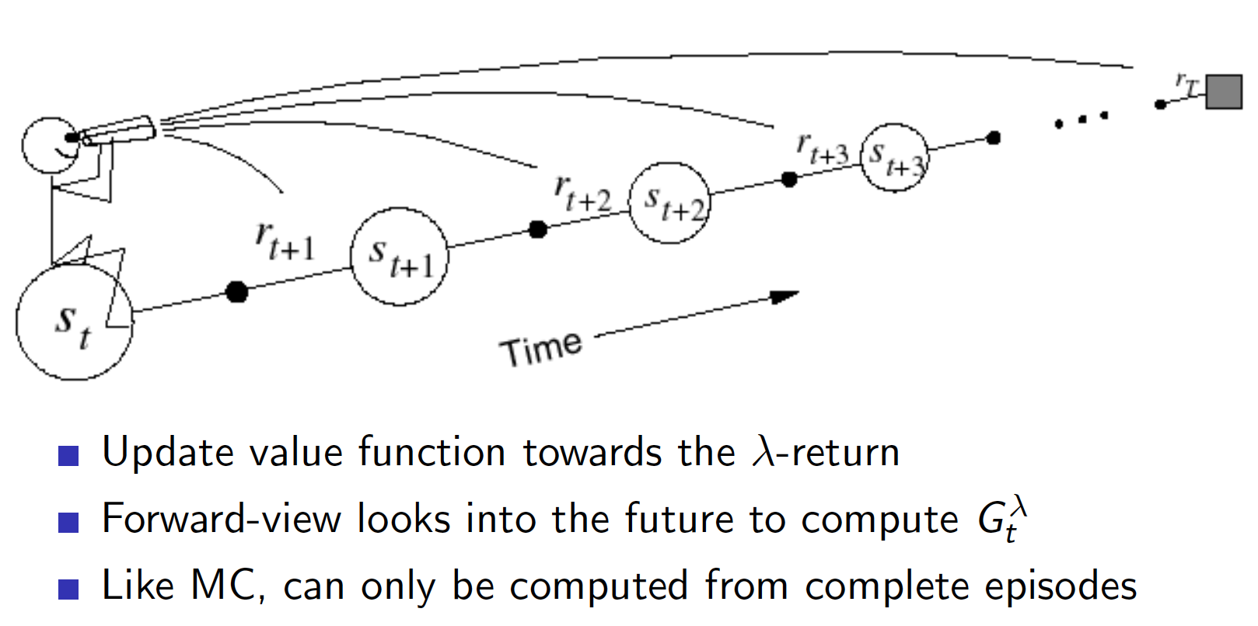
Forward-View TD(λ)

Slide 53
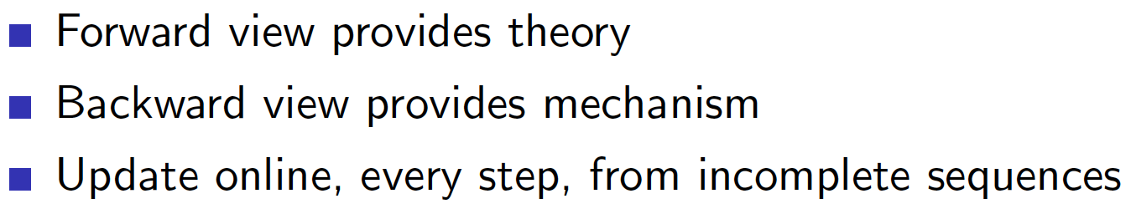
Backward-View TD(λ)

Slide 54
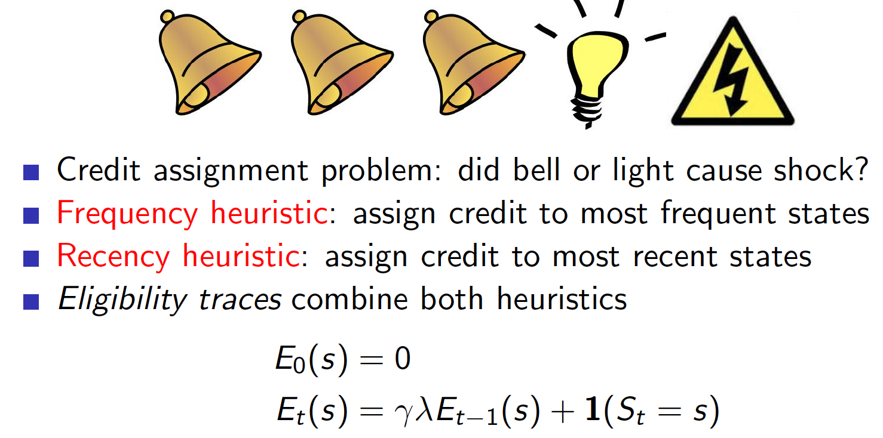
Backward-View TD(λ)
Backward view TD(λ) uses the idea of eligibility traces.
Eligibility Traces:

Slide 55
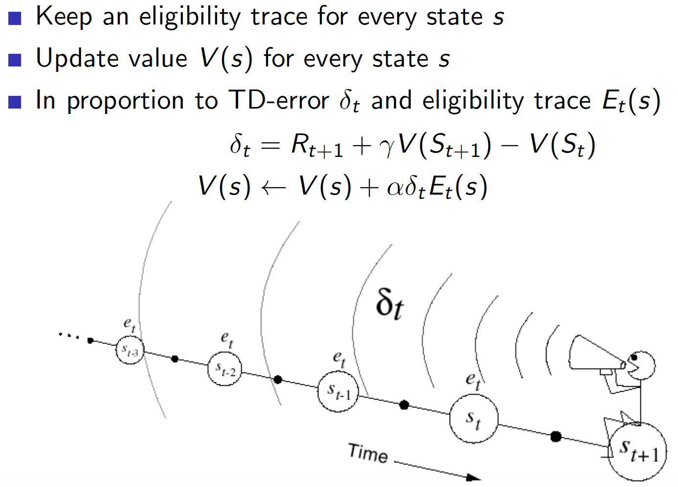
Backward-View TD(λ)

Slide 56
TD(λ), TD(0) and MC
When λ=0, TD(λ) equals TD(0).
When λ=1, TD(λ) is basically Monte-Carlo.

Slide 57
Model-Free Control

Slide 58
Model-Free Control
Monte-Carlo Methods

Slide 59
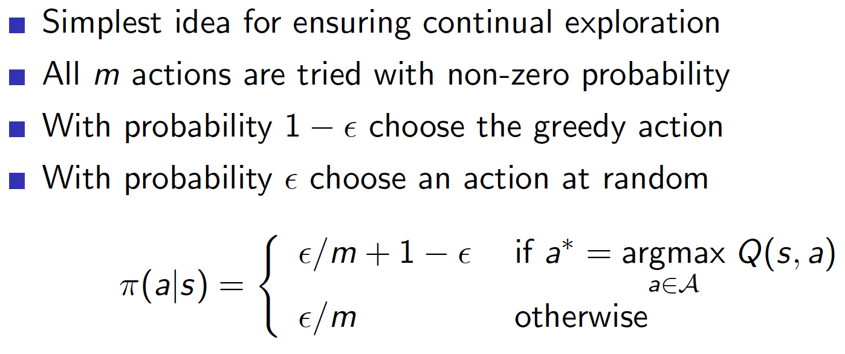
ϵ-Greedy Exploration

Slide 60
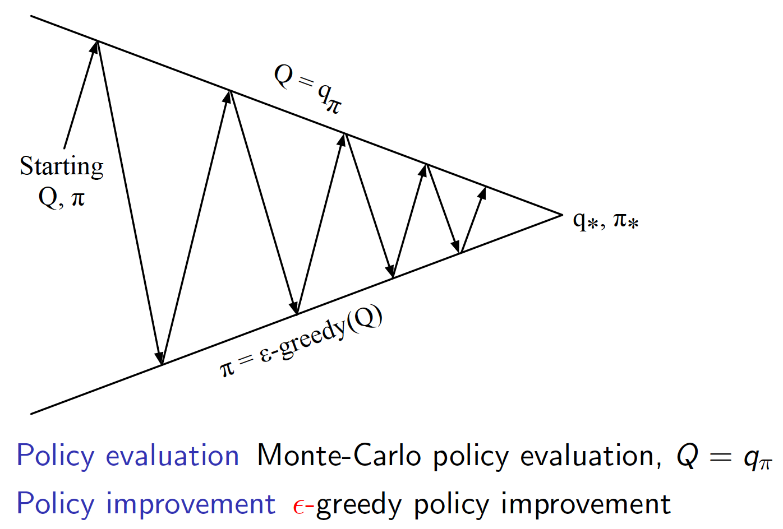
Monte-Carlo Policy Iteration

Slide 61
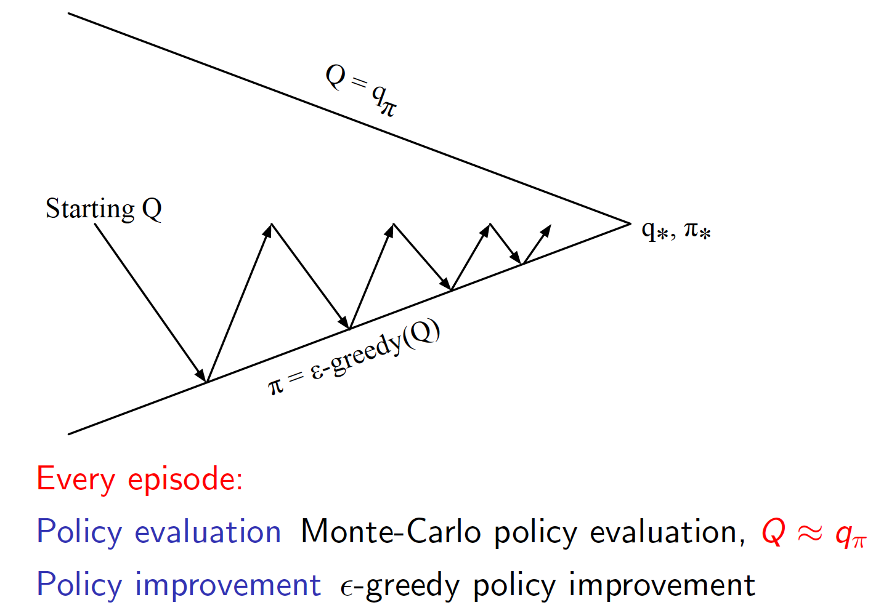
Monte-Carlo Control

Slide 62
Model-Free Control
Temporal-Difference Method

Slide 63

SARSA

Slide 64

Control with SARSA

Slide 65

n-Step SARSA

Slide 66

Forward View SARSA(λ)

Slide 67

Backward View SARSA(λ)

Slide 68

Off-Policy Learning

Slide 69

Q-Learning

Slide 70

Off-Policy Control with Q-Learning

Slide 71

Q-Learning Control Algorithm
Theorem:

Slide 72
Value Function Approximation

Slide 73


Value Function Approximation

Slide 74
Function Approximator
We consider differentiable function approximators, e.g.
Linear combinations of features
Neural Network

Slide 75
Value Function Approximation
Incremental Methods

Slide 76

Incremental Prediction Algorithms

Slide 77

Incremental Control Algorithms

Slide 78
Value Function Approximation
Batch Methods

Slide 79

Batch Reinforcement Learning

Slide 80

Least Squares Prediction

Slide 81

SDG with Experience Replay

Slide 82

Least Squares Control

Slide 83
Policy Gradient

Slide 84


Policy-Based Reinforcement Learning
In this case, we directly parametrize the policy

Slide 85

Policy Objective Functions

Slide 86

Policy Gradient

Slide 87
Computing Policy Gradient
There are different numerical and analytical ways to compute policy gradient, e.g.
Finite Difference Policy Gradient (Numerical approach)
Monte-Carlo Policy Gradient
Actor-Critic Policy Gradient

Slide 88
Policy Gradient
MC Policy Gradient

Slide 89

Score Function

Slide 90

Policy Gradient Theorem
Theorem:

Slide 91

Monte-Carlo Policy Gradient (REINFORCE)

Slide 92
Policy Gradient
Actor-Critic Policy Gradient

Slide 93

Reducing Variance Using a Critic

Slide 94

Estimating the Action-Value Function

Slide 95

Action-Value Actor-Critic

Slide 96

Reducing Variance Using a Baseline

Slide 97

Estimating the Advantage Function

Slide 98

Summary of Policy Gradient Algorithms

Slide 99
Reference
RL Course by David Silver
https://www.youtube.com/watch?v=2pWv7GOvuf0&list=PL7-jPKtc4r78-wCZcQn5IqyuWhBZ8fOxT

Slide 100
Thank You for Your Attention

